Slide 1

Team Details
Team name:The Abstract Thinkers
Team leader name: Mythili
Problem Statement: Surplus Food Rescue

Slide 2

Problem Statement and solution
Excess edible food from events and hotels goes to waste daily due to the lack of a real-time system connecting donors with nearby NGOs. Our solution, the Food Waste Reduction System, provides a simple web and mobile platform where donors can instantly post surplus food details and nearby NGOs receive real-time notifications. This enables quick acceptance and coordinated pickup, ensuring edible food reaches those in need, significantly reducing waste and addressing hunger simultaneously

Slide 3
Opportunities
How different is it from any of the other existing ideas?
How will it be able to solve the problem?
Our project offers a real-time, location-based platform connecting donors directly with nearby NGOs, unlike traditional donation drives that require manual coordination. With instant posting, notifications, and acceptance, surplus food is redistributed promptly, reducing waste and delivering meals efficiently. This immediate and reliable connection ensures timely pickup and transparent tracking, making our solution faster, practical, and more effective than existing methods.

Slide 4
List of features offered by the solution
→ Real-time posting of surplus food by donors
→ Location-based matching with nearby NGOs
→ Instant notifications to NGOs for available food
→ Easy acceptance and pickup coordination
→ Status tracking from posting to collection
→ Transparency and accountability in food redistribution

Slide 5
Google Technologies used in the solution
The **Browser Geolocation API** can be used to detect donor locations, and **Google Maps Platform** can enhance location-based matching. These technologies ensure our platform is scalable, reliable, and capable of real-time operations, making food redistribution fast and efficient.

Slide 6
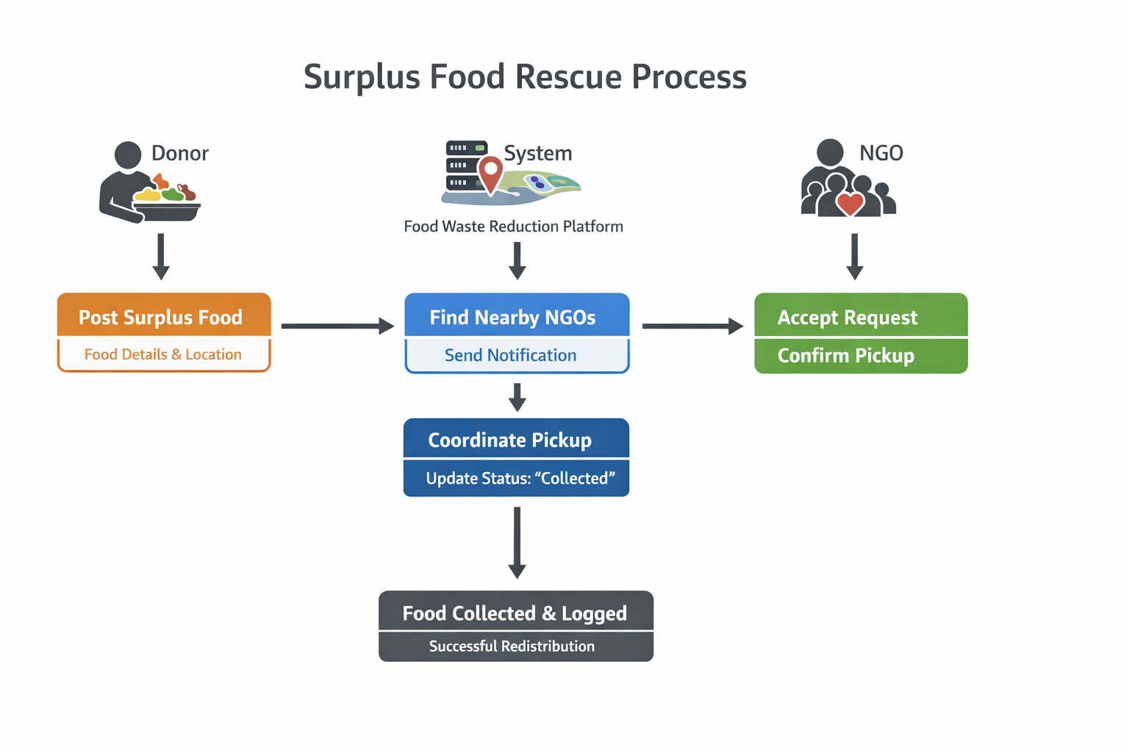
Process flow diagram or Use-case diagram

Slide 7
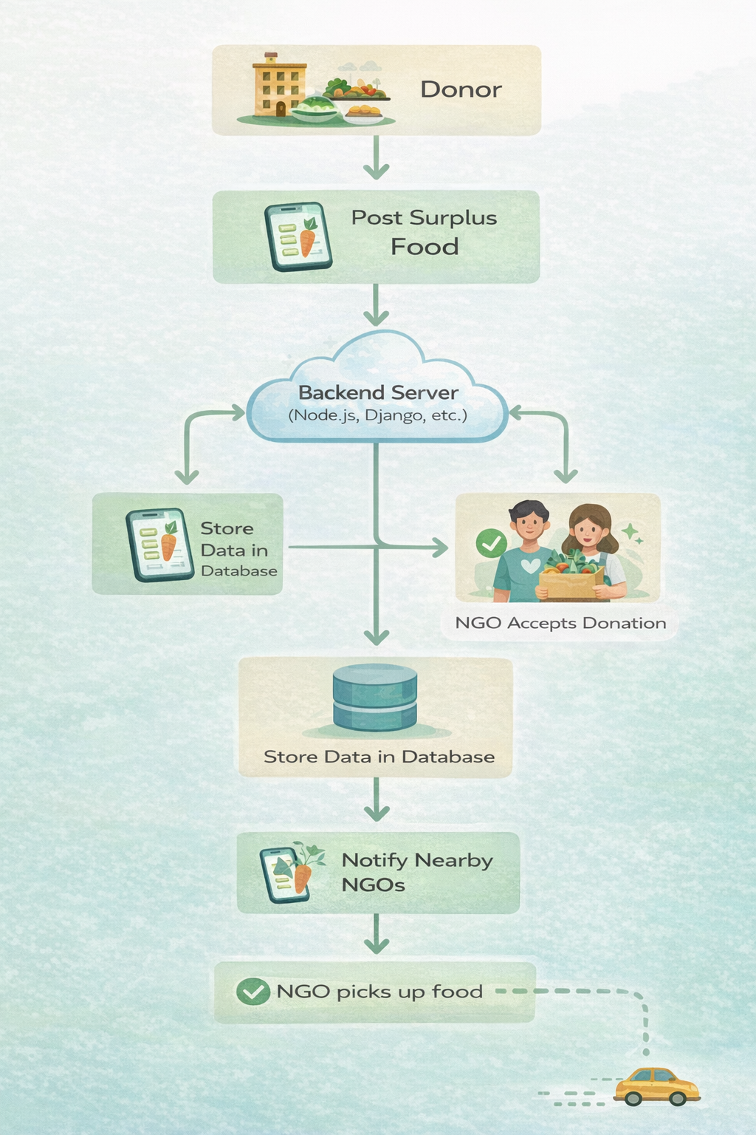
Architecture diagram of the proposed solution

Slide 8
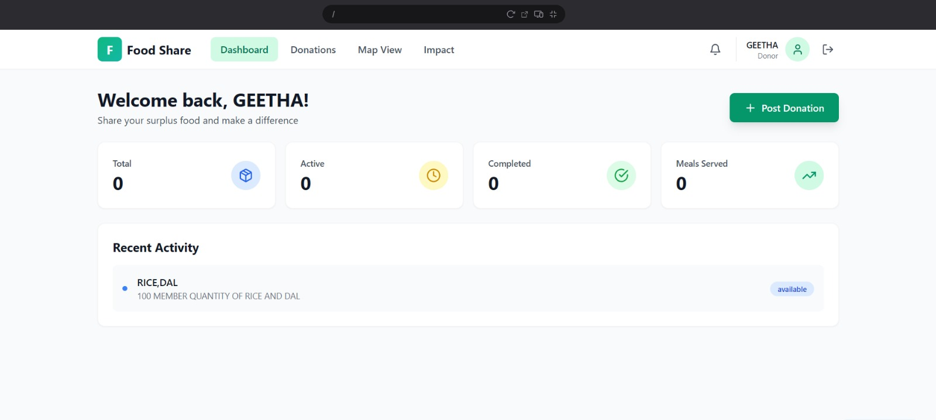
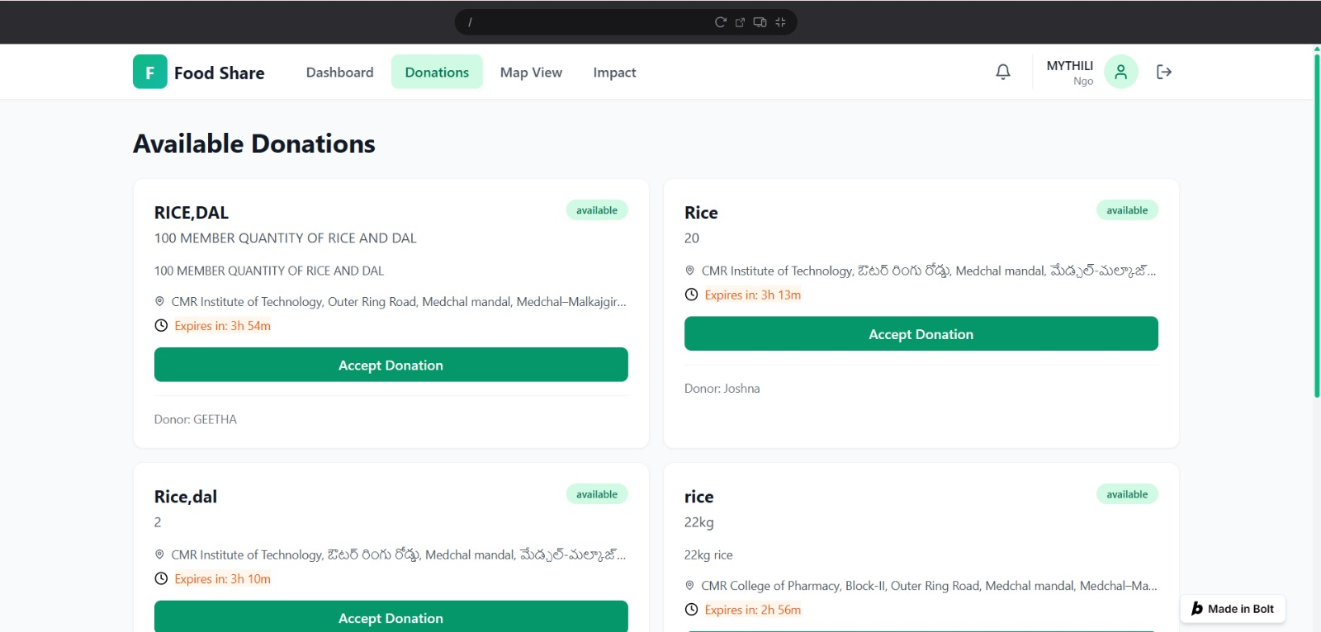
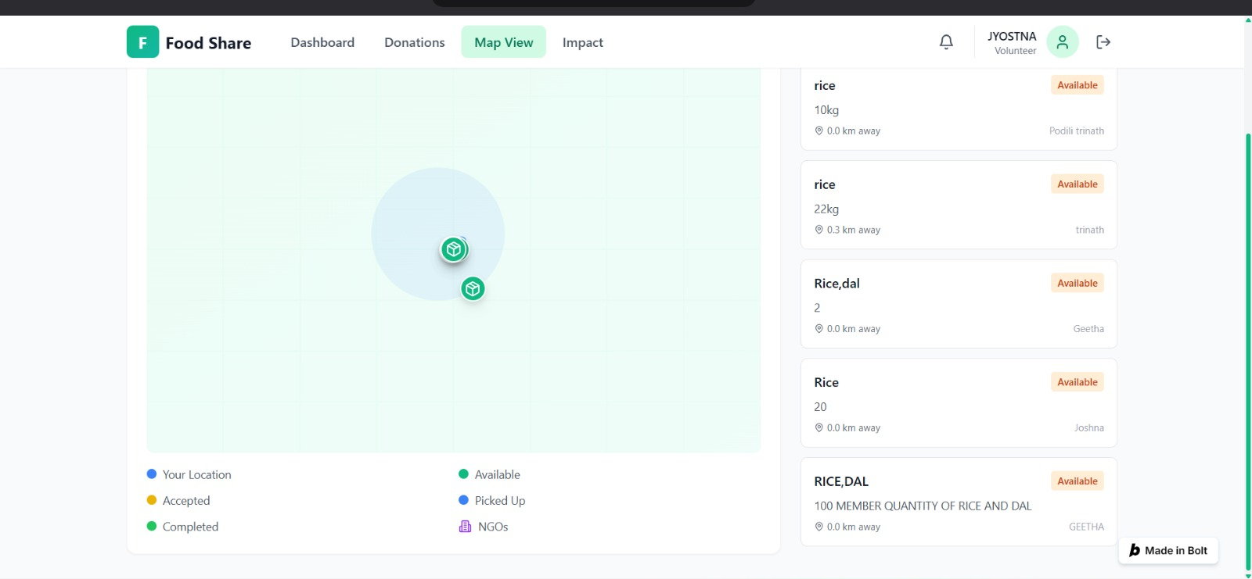
Snapshots of the MVP

Slide 9

Thank you!

